Slide 1
State of Missouri Fingerprint Background Screening
Last Updated: March 6, 2025

Slide 2
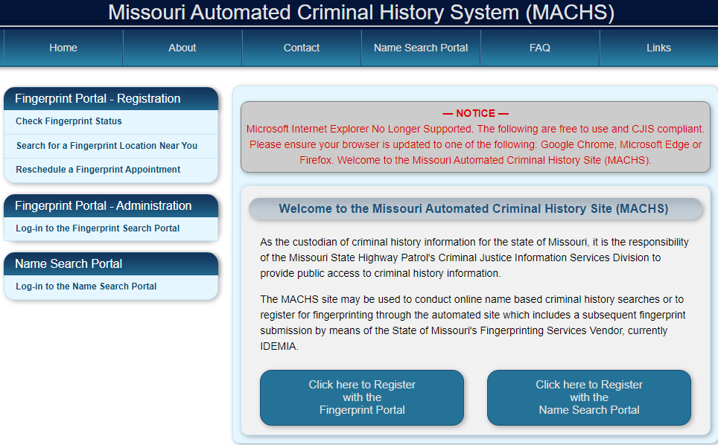
State of Missouri Fingerprint Background Screening
For questions regarding MACHS, contact the MSHP Criminal Justice Information Services Division at (573) 526-6312.
Register with the Missouri Automated Criminal History System (MACHS) at https://www.machs.mo.gov/MACHSFP/home.html
Select the “Click here to Register with the Fingerprint Portal” button.
Notes:
Generally the vendor contacts the Project Manager listed on the PAQ

Slide 3
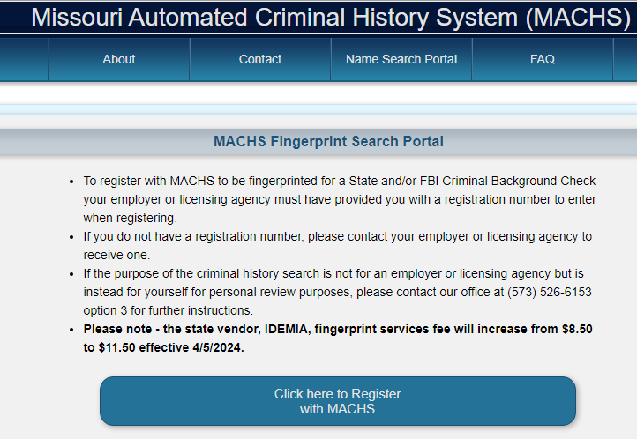
State of Missouri Fingerprint Background Screening
Select the “Click here to Register with MACHS” button after reading the information provided.
Notes:
Generally the vendor contacts the Project Manager listed on the PAQ

Slide 4
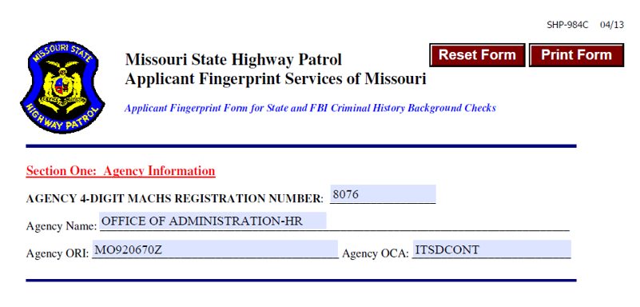
State of Missouri Fingerprint Background Screening
Enter the Agency 4-Digit MACHS Registration number provided below.
Notes:
Generally the vendor contacts the Project Manager listed on the PAQ

Slide 5
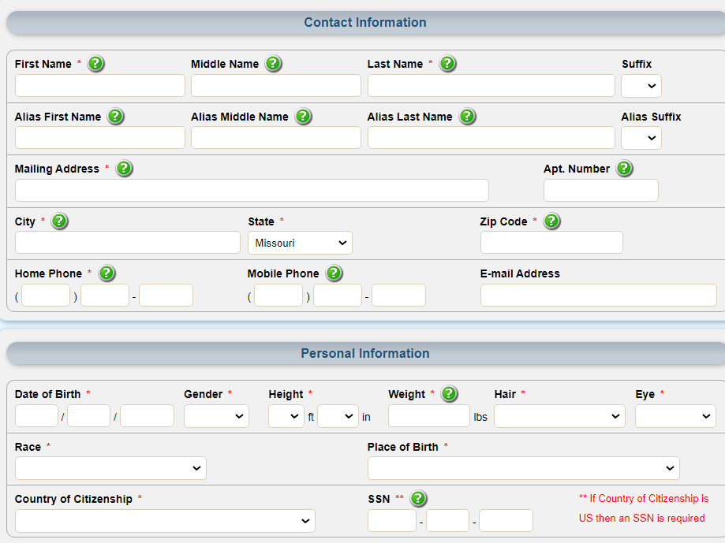
State of Missouri Fingerprint Background Screening
The applicant should complete all demographic information, including an email address. Any field with an asterisk * is a mandatory field.
Notes:
Generally the vendor contacts the Project Manager listed on the PAQ

Slide 6
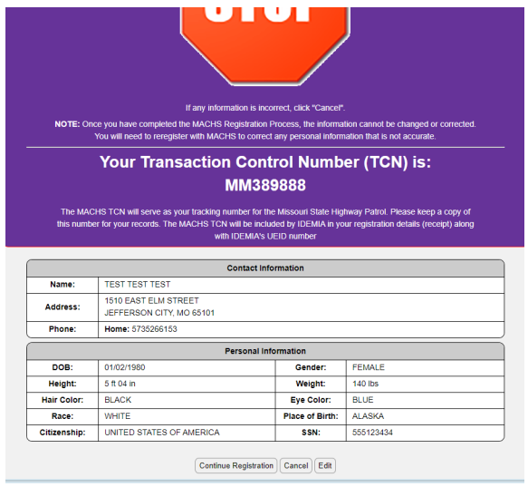
State of Missouri Fingerprint Background Screening
Registration is not complete. Applicant must verify.
Notes:
Generally the vendor contacts the Project Manager listed on the PAQ

Slide 7
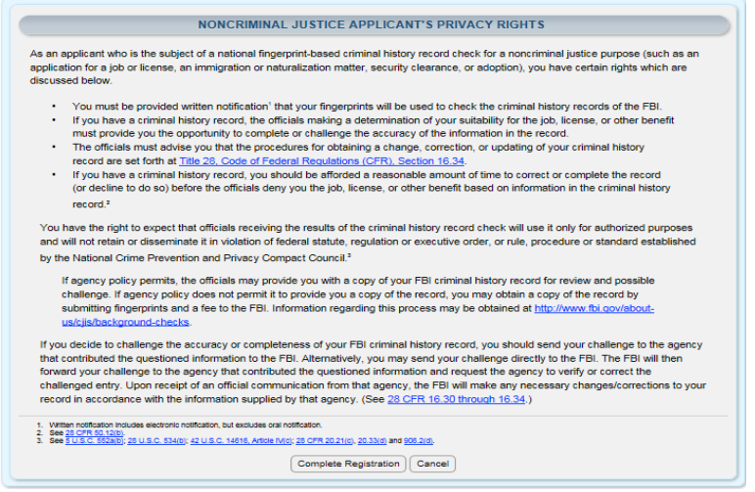
State of Missouri Fingerprint Background Screening
Application Privacy Rights – Applicant must click “Complete Registration” to proceed.
Notes:
Generally the vendor contacts the Project Manager listed on the PAQ

Slide 8
State of Missouri Fingerprint Background Screening
Applicant must confirm information. Click “Correct” to proceed.
Notes:
Generally the vendor contacts the Project Manager listed on the PAQ

Slide 9
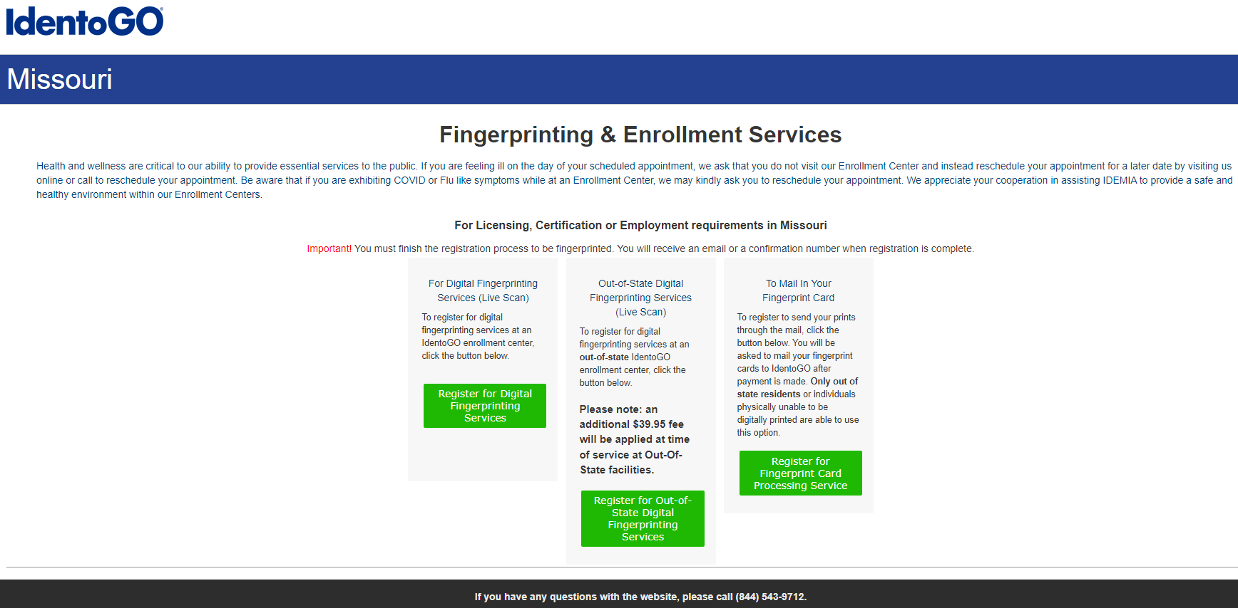
State of Missouri Fingerprint Background Screening - Digital Process in State of Missouri
If you are planning to get a digital fingerprint completed in the State of Missouri, select the Register for Digital Fingerprint Services button.
If you are planning to complete your digital fingerprinting outside the State of Missouri, please go to Page 14. Additional options exist for digital fingerprinting outside the State of Missouri and submission of fingerprint cards if no digital options exist.
Notes:
Generally the vendor contacts the Project Manager listed on the PAQ

Slide 10
State of Missouri Fingerprint Background Screening - Digital Process in State of Missouri
Enter a zip code in the State of Missouri to find a digital fingerprinting location near you.
Notes:
Generally the vendor contacts the Project Manager listed on the PAQ

Slide 11
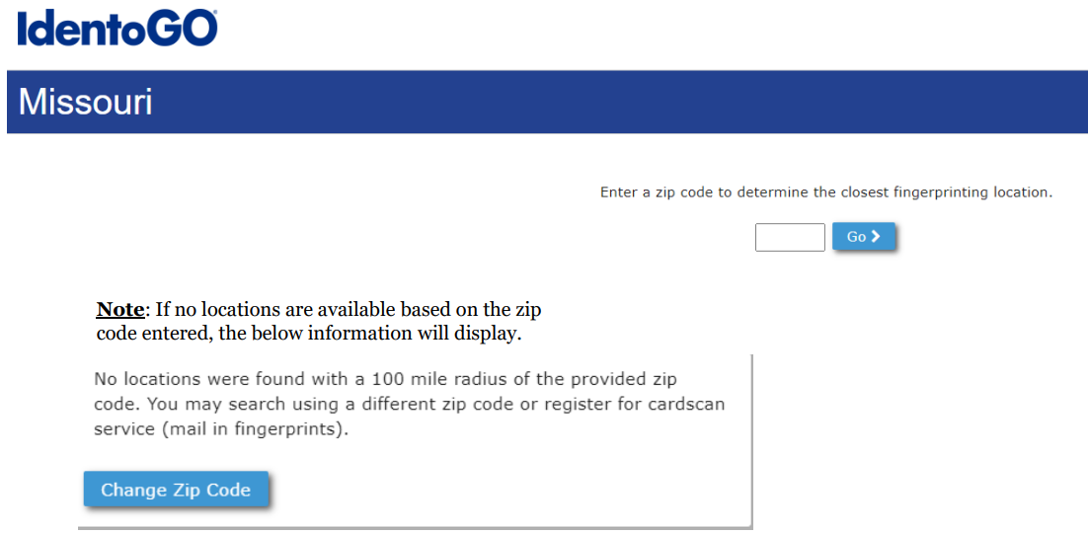
State of Missouri Fingerprint Background Screening - Digital Process in State of Missouri
Notes:
Generally the vendor contacts the Project Manager listed on the PAQ

Slide 12
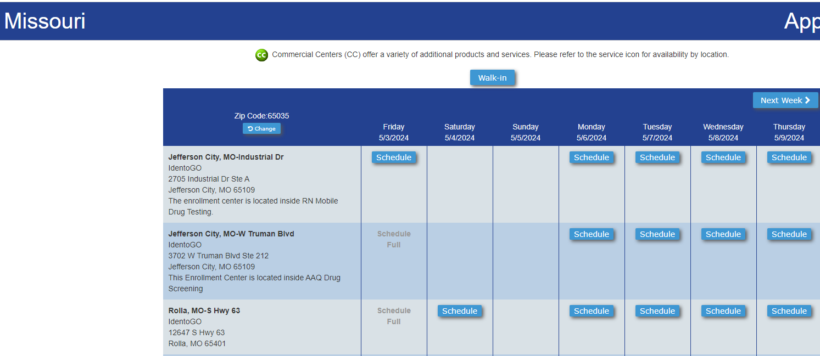
State of Missouri Fingerprint Background Screening - Digital Process in State of Missouri
Notes:
Generally the vendor contacts the Project Manager listed on the PAQ

Slide 13
State of Missouri Fingerprint Background Screening - Digital Process in State of Missouri
Select either Walk-In or schedule a specific time at a specific location for digital fingerprinting.
Notes:
Generally the vendor contacts the Project Manager listed on the PAQ

Slide 14
State of Missouri Fingerprint Background Screening - Digital Process outside State of Missouri
If you are planning to get a digital fingerprint completed outside the State of Missouri, select the Register for Out of State Digital Fingerprint Services button.
Notes:
Generally the vendor contacts the Project Manager listed on the PAQ

Slide 15
State of Missouri Fingerprint Background Screening - Digital Process outside State of Missouri
Enter a zip code to find a digital fingerprinting location near you.
If you are unable to find a location for digital fingerprinting, you will need to register for a Fingerprint Card Processing services. Instructions for the process can be found on page xx.
Notes:
Generally the vendor contacts the Project Manager listed on the PAQ

Slide 16
State of Missouri Fingerprint Background Screening - Digital Process outside State of Missouri
Notes:
Generally the vendor contacts the Project Manager listed on the PAQ

Slide 17
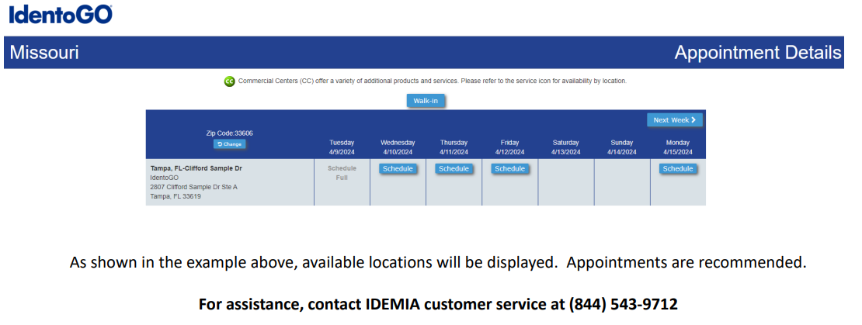
State of Missouri Fingerprint Background Screening - Digital Process outside State of Missouri
Notes:
Generally the vendor contacts the Project Manager listed on the PAQ

Slide 18
State of Missouri Fingerprint Background Screening - Digital Process outside State of Missouri
Select either Walk-In or schedule a specific time at a specific location for digital fingerprinting.
Notes:
Generally the vendor contacts the Project Manager listed on the PAQ

Slide 19
State of Missouri Fingerprint Background Screening - Digital Process outside State of Missouri
Vendor Escrow Account Setup - No Charge Authorization Codes (NCAC)
https://www.identogo.com/uploads/general/MO_NCAC_Account_Application.pdf
Instructions to setup accounts that allow contractor staff to charge the cost of services
Note: Contractor staff can pay at the time of service.
MACHS FAQ Information
https://www.machs.mo.gov/MACHSFP/faq.html
Notes:
Generally the vendor contacts the Project Manager listed on the PAQ

Slide 20
State of Missouri Fingerprint Background Screening - Fingerprint Card Processing Services
If you are unable to get a digital fingerprint completed, select the Register for Fingerprint Card Processing Services button.
Notes:
Generally the vendor contacts the Project Manager listed on the PAQ

Slide 21
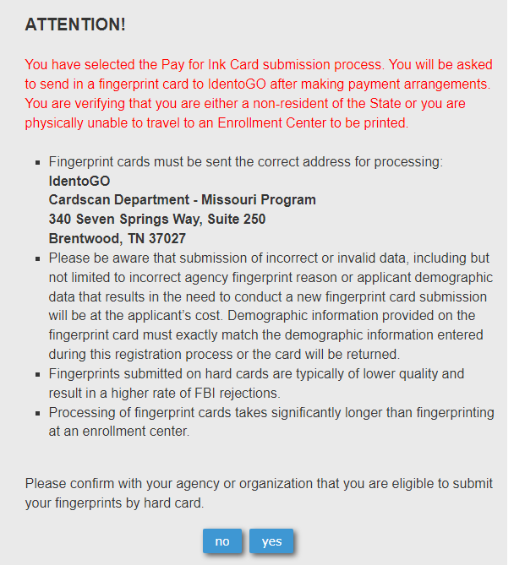
State of Missouri Fingerprint Background Screening - Fingerprint Card Processing Services
Applicant should review the following information and select Yes to continue with the Fingerprint Card Processing Service.
Print and sign the completed pre-enrollment confirmation page, which includes the barcode printed on the top right of the page.
Prints Inc. – IdentoGo Missouri Card Scan Operations
100 Salem Court
Tallahassee, FL 32301
Notes:
Generally the vendor contacts the Project Manager listed on the PAQ

Slide 22
State of Missouri Fingerprint Background Screening - Fingerprint Card Processing Services
When registration is complete, an Applicant should obtain a set of fingerprints from a local law enforcement agency or other entity that provides fingerprinting services. These fingerprints may be either traditional ink rolled fingerprints on a FBI (FD-258) fingerprint card or LiveScan fingerprints printed to a FBI (FD-258) fingerprint card.
Please provide the following information to the technician capturing the fingerprints*
Capturing Four-Finger Slaps:
Fingers must be placed vertically, straight up-and-down, when capturing the four-finger slaps as depicted to the right:
Missouri State Highway Patrol will reject or refuse to process any fingerprint cards that have the four finger slap prints at an angle.
Capturing Individual Fingers:
Each finger and thumb will need to be rolled completely from one side of the fingernail to the other side of the fingernail.
Missouri State Highway Patrol will reject and refuse to process any fingerprint card that contains non-rolled fingerprints.
Submitting Fingerprint Cards:
Fingerprints may be submitted on standard FD-258 FBI applicant cards
The fingerprint card must be completely filled-out in legible print. The following information must be included or the Fingerprint Card will not be processed:
Full name
Date of birth
Social Security Number
Home address
Sex
Height
Weight
Hair color
Eye color
Place of birth (state or country only)
Citizenship
Signature
Notes:
Generally the vendor contacts the Project Manager listed on the PAQ

Slide 23
State of Missouri Fingerprint Background Screening - Fingerprint Card Processing Services
Print and sign the completed pre-enrollment confirmation page, which includes the barcode printed on the top right of the page.
Fingerprint cards must be sent to the correct address for processing:
Prints Inc. – IdentoGo Missouri Card Scan Operations
100 Salem Court
Tallahassee, FL 32301
Please be aware that submission of incorrect or invalid data, including but not limited to incorrect agency fingerprint reason or applicant demographic data that results in the need to conduct a new fingerprint card submission will be at the applicant’s cost.
Demographic information provided on the fingerprint card must EXACTLY match the demographic information entered during the registration process or the card will be returned.
Notes:
Generally the vendor contacts the Project Manager listed on the PAQ

Slide 24
State of Missouri Fingerprint Background Screening - Fingerprint Card Processing Services
Fingerprints submitted on hard cards are typically of lower quality and result in a higher rate of FBI rejections.
Processing of fingerprint cards takes significantly longer than fingerprinting at an enrollment center.
Please send your fingerprint cards via a method that provides tracking ability and be able to provide tracking information upon request.
Additional information can be found on the IdentoGo Missouri website, found at https://www.identogo.com/locations/Missouri.
ITSD Required Documentation – Email Confirmation
Email the individual Contracted Staff Agreement Forms for each resource to the project or resource manager.
Notes:
Generally the vendor contacts the Project Manager listed on the PAQ

